Slide 1
Detecting Fraud in Financial Transactions using SQL

Slide 2
Project Summary
This project uses SQL to analyze financial transaction data from the PaySim dataset. The dataset simulates mobile money transactions and includes information about transaction type, origin and destination accounts, amount, and fraud labels. We perform Exploratory Data Analysis (EDA) and in-depth fraud detection using Common Table Expressions (CTEs), aggregation, filtering, and pattern matching.

Slide 3
Objective
Analyze financial transactions using SQL
Detect patterns and behaviors associated with fraudulent activity
Understand transaction trends, anomalies, and flagged cases

Slide 4
Dataset Overview
Columns:
step, type, amount
nameOrig, oldbalanceOrg, newbalanceOrig
nameDest, oldbalanceDest, newbalanceDest
isFraud, isFlaggedFraud
Over 6 million transactions

Slide 5
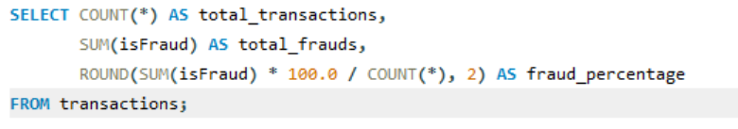
Summary Statistics
What is the total number of transactions and how many are fraudulent?
Out of 6,362,620 total transactions, only 8,213 (0.13%) are fraudulent. This highlights a significant class imbalance, common in fraud detection tasks.

Slide 6
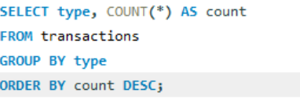
Transaction Types
What is the distribution of transaction types?
The most common transaction types are:
CASH_OUT (2.24M)
PAYMENT (2.15M)
CASH_IN (1.39M)
TRANSFER (532.9K)
DEBIT (41.4K)
This shows that CASH_OUT and PAYMENT dominate the dataset.

Slide 7
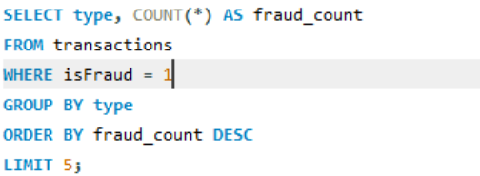
Fraud Types
What are the top 5 most frequent fraud transaction types?
Frauds occur almost exclusively in two transaction types:
CASH_OUT with 4,116 frauds
TRANSFER with 4,097 frauds Other transaction types show negligible or no fraud activity.

Slide 8
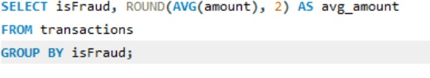
Avg Amount
What is the average transaction amount for fraud vs. non-fraud?
Fraudulent transactions average: ₹1,467,967.30
Non-fraudulent transactions average: ₹178,197.04
Fraudulent transactions are significantly higher in value, indicating frauds are high-stake events.

Slide 9
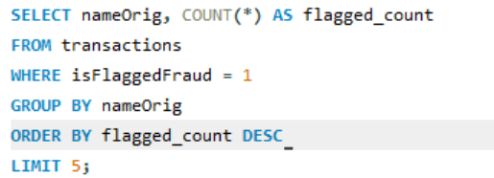
Flagged Accounts
Which accounts initiated the most flagged frauds?
Only five accounts were flagged, each only once. This suggests that flagging is rare or may not always align with actual fraudulent activity.

Slide 10
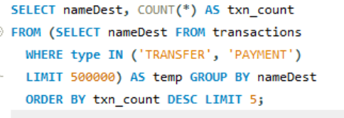
Frequent Destinations
Which destination accounts received the most transactions?
The top destination accounts received between 22 and 26 transactions. These may indicate frequent receivers or potential sinks for illicit transfers.

Slide 11
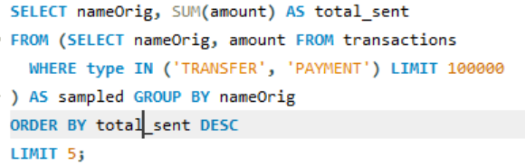
Top Senders
Which origin accounts sent the most money?
The highest sender, C7162498, transferred ₹10 million, followed by others with transfers above ₹6 million. These accounts could be high-value customers or potential fraud sources.

Slide 12
Avg Balance
What is the average balance of fraudulent vs. non-fraudulent origin accounts?
Fraudulent accounts average balance: ₹1.65 million
Non-fraudulent accounts average balance: ₹832.8K Fraud-related accounts maintain nearly double the average balance, possibly to handle large fraudulent transactions.

Slide 13

Type-wise Avg
What is the average amount per transaction type?
TRANSFER: ₹910,647.01 (highest average) . DEBIT: ₹5,483.67
CASH_OUT: ₹176,273.96 . CASH_IN: ₹168,920.24
PAYMENT: ₹13,057.60

Slide 14
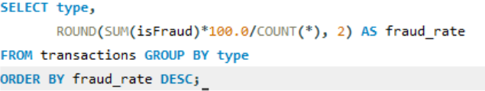
Type-wise Fraud
Which transaction type has the highest average fraud rate?
TRANSFER: 0.77% fraud rate
CASH_OUT: 0.18%
All others: 0%

Slide 15

Unchanged Origin Balance
Are there transactions where the origin balance didn’t change?
There are 2,089,037 transactions where the origin balance remained unchanged after the transaction—possibly anomaly or logging error.

Slide 16

Unchanged Destination Balance
Are there transactions where the destination balance didn’t change?
In 2,317,292 transactions, the destination balance didn’t change, raising questions about failed updates or dummy transactions.

Slide 17
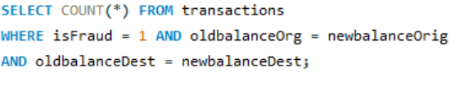
Static Balances in Fraud
How often are both origin and destination balances unchanged in frauds?
In 32 fraudulent transactions, neither balance changed, indicating potential simulation frauds or dataset integrity issues.

Slide 18

Flagging System
How many frauds were flagged by the system?
Only 16 frauds were flagged by the system, which is very low compared to the actual number of frauds (8,213). This suggests a poor performance of the current fraud detection mechanism.

Slide 19
Flagged vs Actual
What percentage of frauds were flagged by the system?\
The system correctly flagged only 0.19% of the total frauds. This indicates a very low detection accuracy, and the flagging logic needs significant improvement.

Slide 20
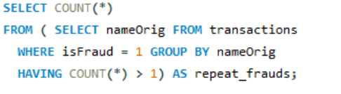
Repeated Fraudsters
How many accounts were involved in more than one fraud?
Zero accounts were involved in more than one fraud, suggesting that frauds were typically one-off incidents per account, or fraudsters may be using different accounts each time to avoid detection.

Slide 21
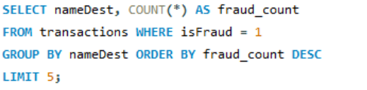
Top Fraud Destinations
Which destination accounts were involved in most frauds?
Five destination accounts were each involved in 2 fraudulent transactions. These accounts may be repeat receivers of fraudulent funds

Slide 22
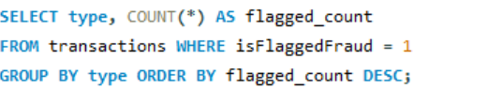
Type vs Flagged Fraud
Which transaction types were most frequently flagged as fraud?
All 16 flagged transactions were of type TRANSFER, confirming that the system’s flagging mechanism targets only one transaction type.

Slide 23

Fraud by Step
At which transaction steps does fraud occur most frequently?
Fraudulent transactions peaked at simulation step 212, with 40 cases, suggesting that fraud is more likely to occur at specific time intervals in the system.

Slide 24
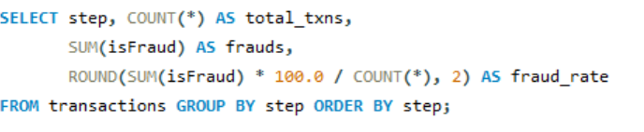
Fraud Rate Over Time
What is the fraud percentage over time (per step)?
Fraud changes over time. Steps 1–6 had some fraud, maybe early testing. Steps 7–20 were stable with very little fraud. Steps 25–32 showed sudden jumps, likely attacks. Steps 50–90 had high fraud, maybe from bots. After Step 93, fraud dropped and the system became stable again

